Slide 1
CS101 Introduction to Computing
Lecture 9
HTML Lists & Tables
(Web Development Lecture 3)

Slide 2
Today is our 3rd Web Dev lecture During our 2nd lecture on Web dev …
We learnt to develop our own Web pages in HTML
We learnt about some of the tags used in HTML pages
  <BR>, <P>, </P>, <B>, <TITLE>, </TITLE>, <H1>, </H1>
  <HTML></HTML>, <HEAD></HEAD>, <BODY></BODY>
  <A HREF = “action” > label </A>, action=http:// or mailto:
We also learnt about how to upload our Web pages to VU’s Web server so that it becomes visible on the Internet as http://www.vu.edu.pk/~xxxxxxxx/
where xxxxxxxx is your VU user ID

Slide 3
Today’s Lecture
We will extend our Web pages by adding a few more tags
Specifically, we will learn about various types of lists that can be added to a Web page
And also, about tables

Slide 4
But first …
A few comments on the general structure of HTML tags

Slide 5
Single Tags
<tagName>
Example: <BR>

Slide 6
Single Tags with Atributes
<tagName attributes>
Example: <HR width=“50%”>

Slide 7
Paired Tags
<tagName> … </tagName>
Example: <H1> … </H1>

Slide 8
Paired Tags with Attributes
<tagName attributes > … </tagName>
Example: <H1 align=“center”> … </H1>

Slide 9
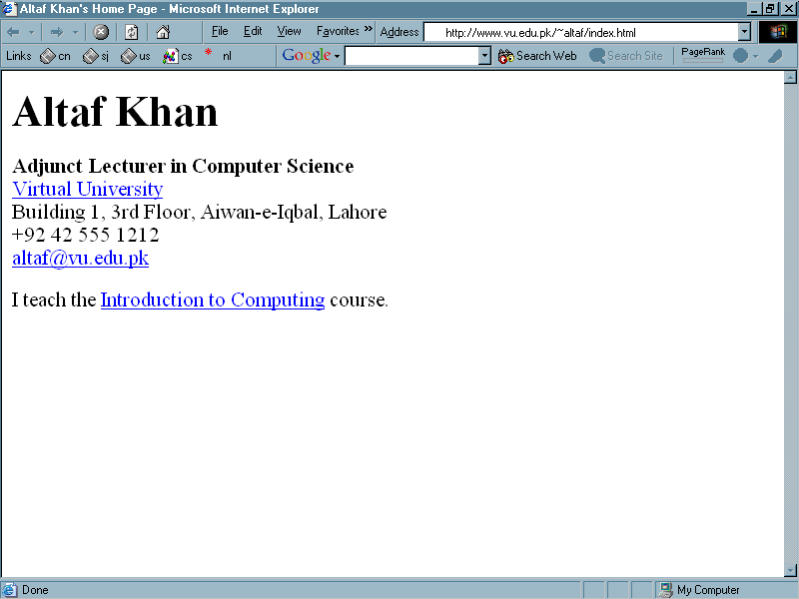

Slide 10
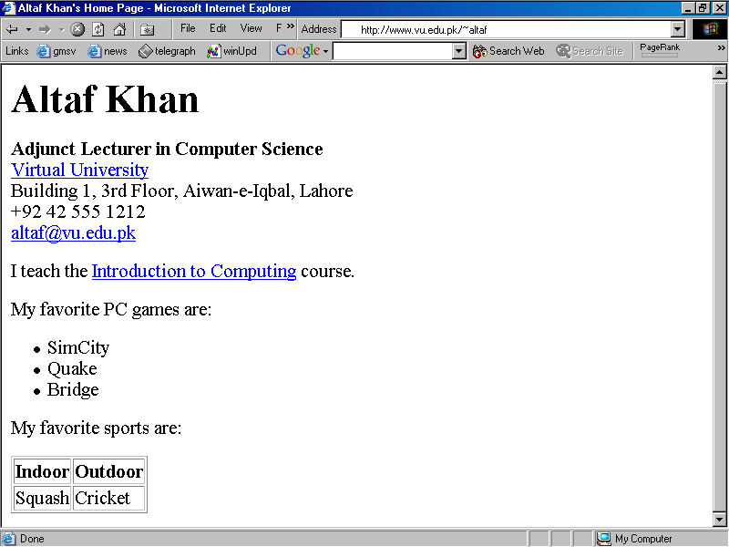

Slide 11
List

Slide 12
Table

Slide 13
<HTML>
<HEAD>
<TITLE>Altaf Khan's Home Page</TITLE>
</HEAD>
<BODY>
<H1>Altaf Khan</H1>
<P><B>Adjunct Lecturer in Computer Science</B><BR>
<A HREF="http://www.vu.edu.pk/">Virtual University</A><BR>
Building 1, 3rd Floor, Aiwan-e-Iqbal, Lahore<BR>
+92 42 555 1212<BR>
<A HREF="mailto:altaf@vu.edu.pk">altaf@vu.edu.pk</A><BR></P>
<P>I teach the <A HREF="http://www.vu.edu.pk/cs101/">Introduction to Computing</A> course. </P>
</BODY>
</HTML>

Slide 14
<HTML>
<HEAD>
<TITLE>Altaf Khan's Home Page</TITLE>
</HEAD>
<BODY>
<H1>Altaf Khan</H1>
<P><B>Adjunct Lecturer in Computer Science</B><BR>
<A HREF="http://www.vu.edu.pk/">Virtual University</A><BR>
Building 1, 3rd Floor, Aiwan-e-Iqbal, Lahore<BR>
+92 42 555 1212<BR>
<A HREF="mailto:altaf@vu.edu.pk">altaf@vu.edu.pk</A><BR></P>
<P>I teach the <A HREF="http://www.vu.edu.pk/cs101/">Introduction to Computing</A> course. </P>
</BODY>
</HTML>
The additional code for the list and table goes here

Slide 15
<P>My favorite PC games are:</P>
<UL>
<LI>SimCity</LI>
<LI>Quake</LI>
<LI>Bridge</LI>
</UL>
<P>My favorite sports are:</P>
<TABLE border = “1” >
<TR>
<TH>Indoor</TH>
<TH>Outdoor</TH>
</TR>
<TR>
<TD>Squash</TD>
<TD>Cricket</TD>
</TR>
</TABLE>
Additional
code

Slide 16
<P>My favorite PC games are:</P>
<UL>
<LI>SimCity</LI>
<LI>Quake</LI>
<LI>Bridge</LI>
</UL>
<P>My favorite sports are:</P>
<TABLE border = “1” >
<TR>
<TH>Indoor</TH>
<TH>Outdoor</TH>
</TR>
<TR>
<TD>Squash</TD>
<TD>Cricket</TD>
</TR>
</TABLE>
Code for the list
Code for the table

Slide 17
HTML Code
Browser Display
<UL>
<LI>SimCity</LI>
<LI>Quake</LI>
<LI>Bridge</LI>
</UL>
  SimCity
  Quake
  Bridge

Slide 18
<UL> | Un-ordered List
<LI> | Line Item

Slide 19
The default “bullet” for these lists is a “disc”
That, however, can be changed to a “circle” or a “square” with the help of the type attribute

Slide 20
HTML Code
Browser Display
<UL type = “circle”>
<LI>SimCity</LI>
<LI>Quake</LI>
<LI>Bridge</LI>
</UL>
  SimCity
  Quake
  Bridge

Slide 21
type = “square”

Slide 22
Q: What happens if I start a new list without closing the original one?
<UL>
<LI>SimCity</LI>
<LI>Quake II</LI>
<UL>
<LI>SimCity 3000</LI>
<LI>Quake III</LI>
</UL>
<LI>Bridge</LI>
</UL>

Slide 23
Browser Display
Different bullets
Additional tab
  SimCity
  Quake II
    SimCity 3000
    Quake III
  Bridge

Slide 24
Such structures, i.e., those in which another starts before the first list is finished, are called Nested Lists

Slide 25
Types of Lists
In addition to un-ordered lists, HTML supports two other types
  Ordered Lists
  Definition List

Slide 26
Ordered List
Browser Display
OL instead of UL
<OL>
<LI>SimCity</LI>
<LI>Quake</LI>
<LI>Bridge</LI>
</OL>
  SimCity
  Quake
  Bridge
Numbers instead of discs, circles or squares

Slide 27
Ordered List
Browser Display
<OL type = “a”>
<LI>SimCity</LI>
<LI>Quake</LI>
<LI>Bridge</LI>
</OL>
  SimCity
  Quake
  Bridge

Slide 28
Ordered List Types
type | Result
“A” | A, B, C, …
“a” | a, b, c, …
“I” | I, II, III, IV, …
“i” | i, ii, iii, iv, …
“1” | 1, 2, 3, …

Slide 29
Q: How would one start an ordered list with something other than 1
Browser Display
  SimCity
  Quake
  Bridge

Slide 30
Ordered List
Browser Display
<OL start = “25”>
<LI>SimCity</LI>
<LI>Quake</LI>
<LI>Bridge</LI>
</OL>
  SimCity
  Quake
  Bridge

Slide 31
Definition List
Browser Display
<DL>
<DT>SimCity</DT>
  <DD>A great simulation game in which one build cities </DD>
<DT>Quake</DT>
  <DD> One of the best of the shoot-em-up genre </DD>
</DL>
SimCity
A great simulation game in which one build cities
Quake
One of the best of the shoot-em-up genre
Term
Definition

Slide 32
<DL> | Definition List
<DT> | Term
<DD> | Definition

Slide 33
Ordered lists as well as definition lists can be nested just like the un-ordered lists
Can any type of list be nested into any other type?

Slide 34
Lists are one way of presenting data in a an ordered or formal fashion
Tables provide another - more customizable - way of displaying ordered information on Web pages

Slide 35
Browser Display
Indoor | Outdoor
Squash | Cricket

Slide 36
HTML Code
Browser Display
<TABLE border = "1" >
<TR>
<TH>Indoor</TH>
<TH>Outdoor</TH>
</TR>
<TR>
<TD>Squash</TD>
<TD>Cricket</TD>
</TR>
</TABLE>
Indoor | Outdoor
Squash | Cricket

Slide 37
<TABLE> | Table (made up of rows)
<TR> | Row (made up of data cells)
<TH> | Heading Data Cell (Can contain paragraphs, images, lists, forms, tables)
<TD> | Data Cell (Can contain paragraphs, images, lists, forms, tables)

Slide 38
<TABLE> Attributes
BORDER
  Determines the thickness of the table border
  Example: <TABLE BORDER = “2”>
CELLPADING
  Determines the distance between the border of a cell and the contents of the cell
  Example: <TABLE CELLPADDING = “3”>
CELLSPACING
  Determines the empty spacing between the borders of two adjacent cells
  Example: <TABLE CELLSPACING = “1”>

Slide 39
HTML Code
Browser Display
<TABLE border = "1" >
<TR>
<TH>Indoor</TH>
<TH>Outdoor</TH>
</TR>
<TR>
<TD>Squash</TD>
<TD>Cricket</TD>
</TR>
</TABLE>
Indoor | Outdoor
Squash | Cricket

Slide 40
HTML Code
Browser Display
<TABLE>
<TR>
<TH>Indoor</TH>
<TH>Outdoor</TH>
</TR>
<TR>
<TD>Squash</TD>
<TD>Cricket</TD>
</TR>
</TABLE>
Indoor | Outdoor
Squash | Cricket

Slide 41
<TABLE>,<TR>,<TH>,<TD> Attributes
ALIGN
  Possible values: Center, Left, Right
  Example: <TH ALIGN = “center”>
BGCOLOR
  Example: <TD BGCOLOR = “red”>
WIDTH
  Example: <TR WIDTH = “40%”>
HEIGHT
  Example: <TABLE HEIGHT = “200”>
50% of the screen width

Slide 42
<TR> Attributes
VLAIGN
  Determines the vertical alignment of the contents of all of the cells in a particular row
  Possible values: Top, Middle, Bottom
  Example: <TR VALIGN = “bottom”>

Slide 43
<TH> & <TD> Attributes
NOWRAP
  Extend the width of a cell, if necessary, to fit the contents of the cell in a single line
  Example: <TD NOWRAP>
COLSPAN
  No. of rows the current cell should extend itself downward
  Example: <TD COLSPAN = “2”>
ROWSPAN
  The number of columns the current cell should extend itself
  Example: <TD ROWSPAN = “5”>
VALIGN
  Same as that for <TR>

Slide 44
HTML Code
Browser Display
<TABLE border=“1” >
<TR>
<TH colspan=“2”> Indoor Outdoor
</TH>
</TR>
<TR>
<TD>Squash</TD>
<TD>Cricket</TD>
</TR>
</TABLE>
Indoor Outdoor
Squash | Cricket

Slide 45
Year | Quarter | Expenses |  | Income
 |  | Quetta | Dubai | Quetta | Dubai
2001 | 1 | 1,900 | 8,650 | 9,000 | 7,780
 | 2 | 2,230 | 8,650 | 8,500 | 8,670
 | 3 | 4,000 | 8,650 | 9,900 | 9,870
 | 4 | 2,200 | 8,650 | 9,800 | 9,900
2002 | 1 | 7,780 | 8,650 | 7,780 | 9,000
 | 2 | 8,670 | 8,650 | 8,670 | 8,500
 | 3 | 9,870 | 8,650 | 9,870 | 9,900
 | 4 | 9,900 | 8,650 | 9,900 | 9,800

Slide 46
HTML Code
Browser Display
<TABLE border = "1" >
<CAPTION>
My favorite sports
</CAPTION>
<TR>
<TD>Squash</TD>
<TD>Cricket</TD>
</TR>
</TABLE>
My favorite sports
Squash | Cricket

Slide 47
HTML Code
Browser Display
<TABLE border = "1" >
<CAPTION>
My favorite sports
</CAPTION>
<TR>
<TD>Squash</TD>
<TD>Cricket</TD>
</TR>
</TABLE>
My favorite sports
Squash | Cricket
Must be placed immediately after the<TABLE> tag

Slide 48
Useful URL
The Table Sampler
http://www.netscape.com/assist/net_sites/table_sample.html

Slide 49
In Today’s Lecture …
We learnt how to extend our Web pages by adding a few more tags
Specifically, we discussed various types of lists that can be added to a Web page – un-ordered, ordered and definition lists
And also, about tables: about various tags used in a table and their associated attributes

Slide 50
Next Web Dev Lecture:
Interactive Forms
We will try to understand the utility of forms on Web pages
We will find out about the various components that are used in a form
We will become able to build a simple, interactive form

